Slide 1

BTC Trading Signal Generation: Integrating Market Microstructure and Technical Indicators
BO-LING TSENG YUN-TSE LAN
Aye Mya Thandar
(314707007) (112705059)
(313712020)

Slide 2
Agenda
Motivation
Introduction
Data
Benchmark model
Study plan
result
IDA Template

Slide 3
Motivation

Slide 4
Project Motivation
Bitcoin market, is highly volatile but full of trading opportunities.
Traditional regression models can't capture complex, nonlinear market behaviors.
We use machine learning with order book imbalance and technical indicators to predict short-term returns.
Dynamic stop-loss and take-profit rules optimize the Sharpe ratio , balancing profit and risk.
Our goal is to build a robust that outperforms traditional models and adapts to market volatility.

Slide 5
Introduction

Slide 6
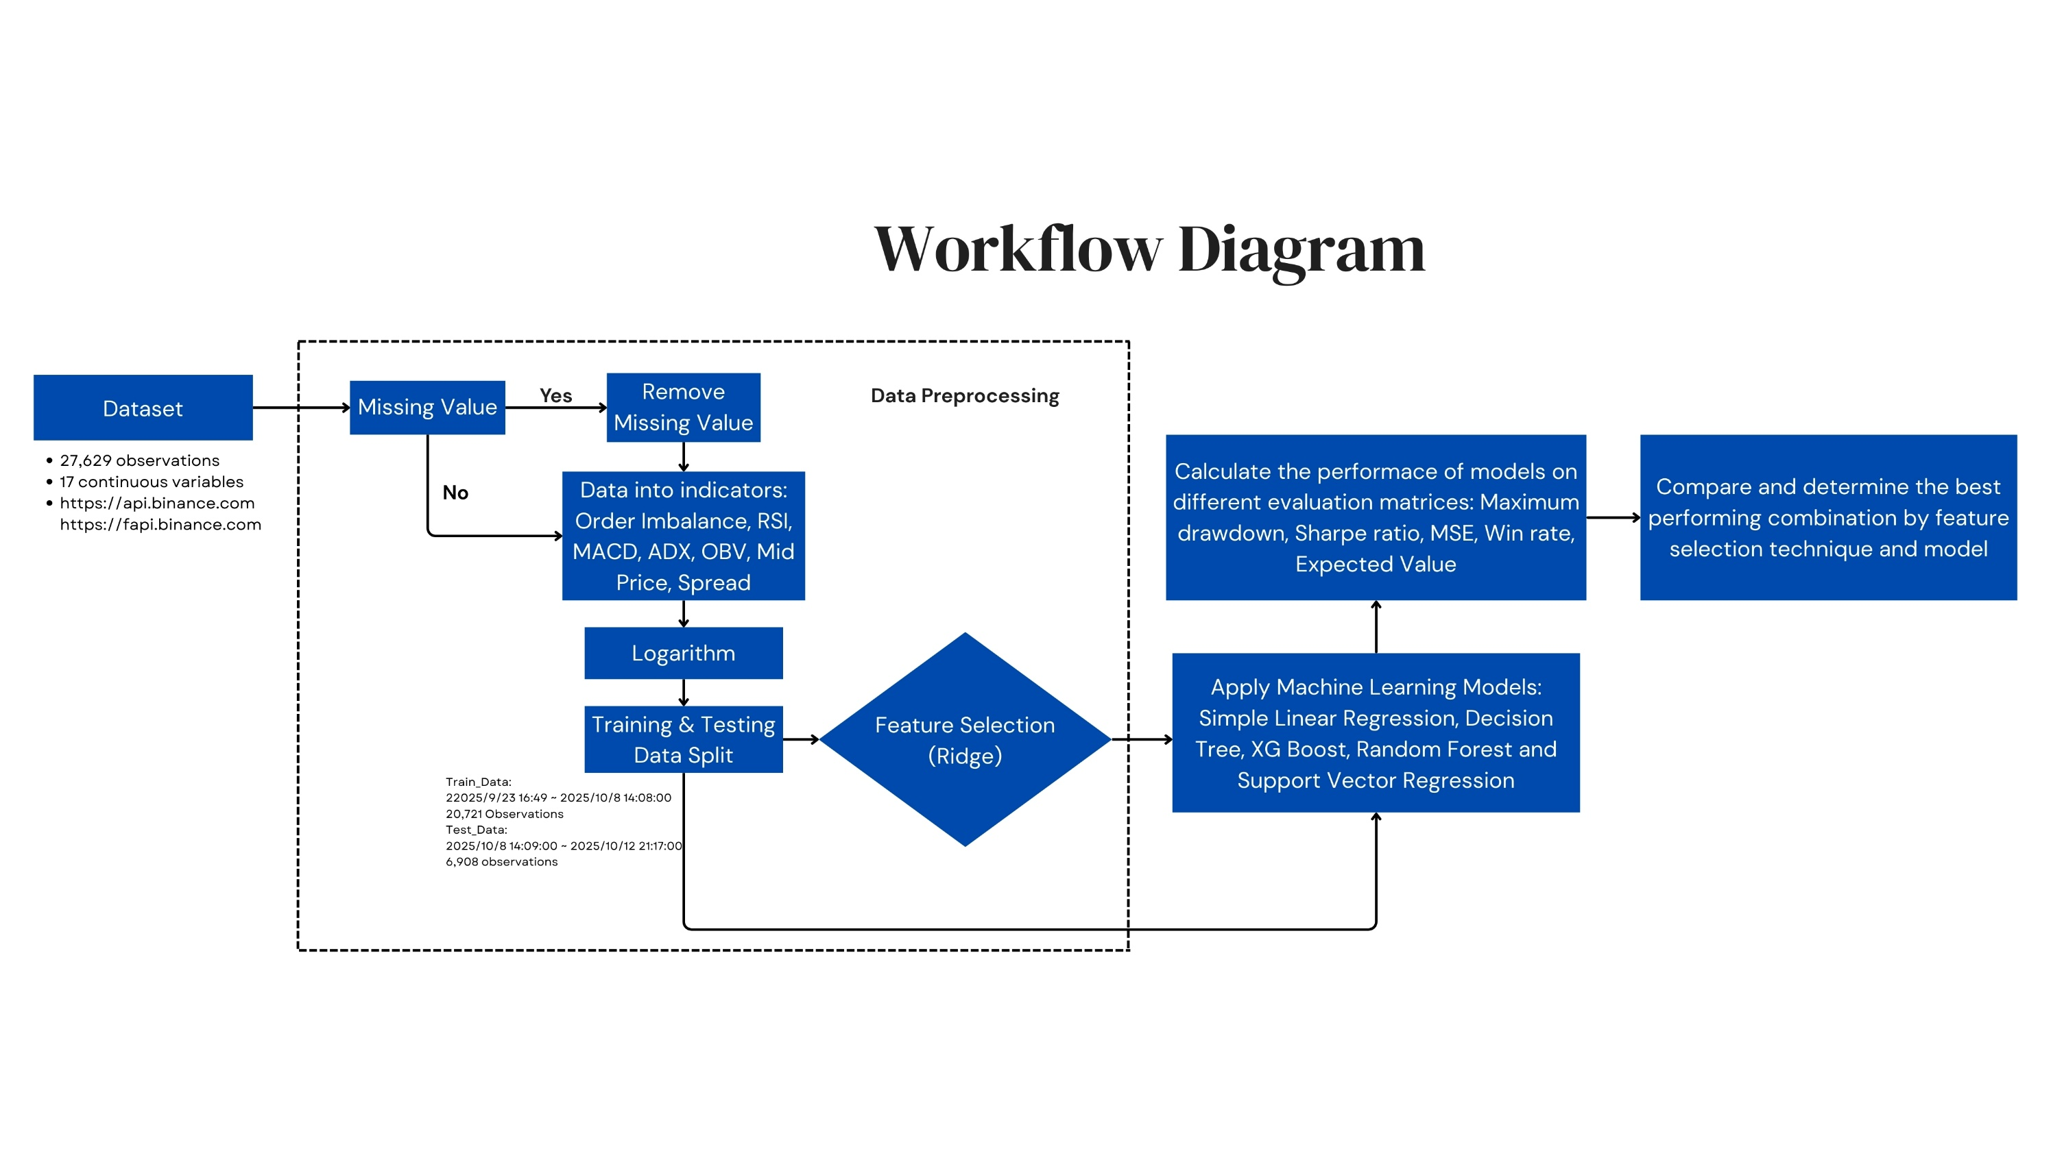
Overview Study Plan
IDA Template

Slide 7
Trading strategy
We use the following model to predict future returns, y_pred:
1. Linear Regression (LR)-----------Benchmark model
2. Support Vector Regression (SVR)
3. XGBoosting (XGB)
4. Decision Tree (DT)
5. Random Forest (RF)

Slide 8
Trading strategy
Trading Logic
Trading decisions were derived from the predicted return 𝑦_pred ​relative to a transaction-cost threshold fee.
Long Entry → ​
Short Entry →
𝑦_pred > fee
𝑦_pred < −fee
IDA Template

Slide 9
Trading strategy
The strategy uses ATR-based dynamic thresholds to manage each open position.
Fixed ATR Multipliers, TP, SL:
take profit: position’s return > TP × ATR%[t]
stop-loss: position’s return < −SL × ATR%[t]
Parameter Optimization & Evaluation:
A grid search is performed over TP and SL in the range [0.5, 3.0] with increments of 0.1.
Backtest on the training set.
Maximizes the annualized Sharpe ratio is selected.
IDA Template
Notes:
TP for take-profit and SL for stop-loss—to build a volatility-adjusted exit strategy.

Slide 10
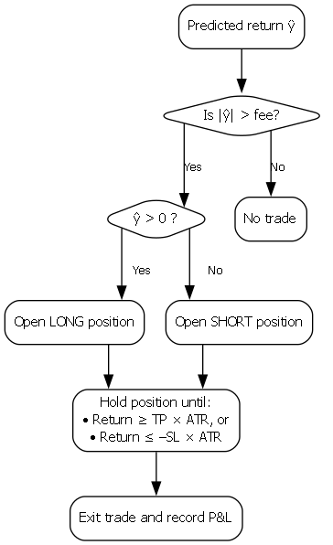
IDA Template

Slide 11


Performance Measurements
Sharpe Ratio = (annual return – risk free rate) / annual_volatility
Maximum Drawdown = (maximum cumulative return - cumulative return)/ maximum cumulative return
Win Rate = Number of winning trades / total number of trades
Expected Value = p(win)*u(win)+p(loss)*u(loss)
MSE (Mean Squared Error)
Compound Annual Growth Rate, CAGR
IDA Template

Slide 12
Data

Slide 13
Data
1-minute high-frequency data for the BTC/USDT trading pair.
Collected from the Binance Exchange public API.
Order book depth
K-line data (OHLCV)
futures market open interest
IDA Template

Slide 14
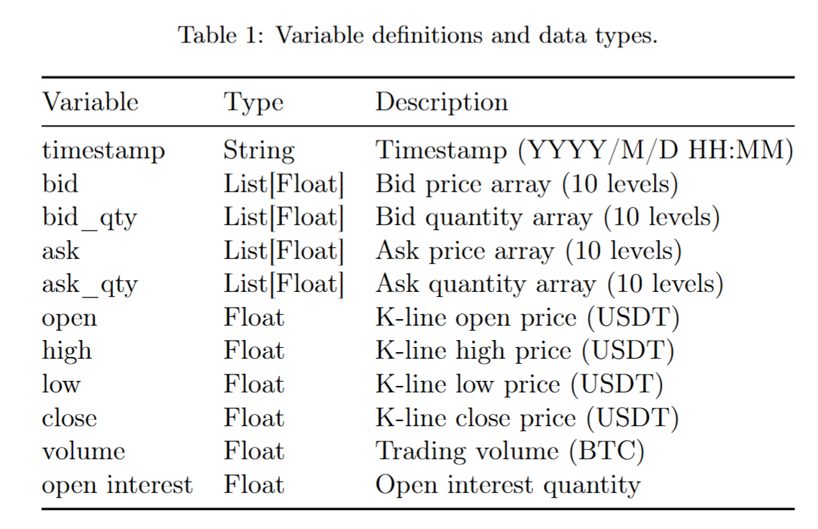
Data
IDA Template
Notes:
Raw data varieble
the bid and ask arrays up to 10 levels

Slide 15
Data
Training set: 2025/9/23 16:49 ~ 2025/10/8 14:08:00
Total: 21,440 data
Test set: 2025/10/8 14:09:00 ~ 2025/10/12 21:17:00
Total: 6,189 data
IDA Template

Slide 16
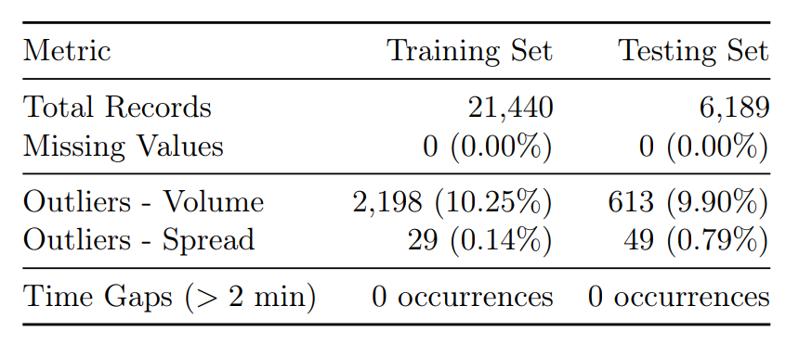
EDA Outcome and Analysis
Data Quality Assessment
No Missing Data
Volume outliers reflecting the fat-tailed, impulse-like nature of cryptocurrency trading activity rather than data errors.
IDA Template
Notes:
There were no missing values or time gaps.

Slide 17
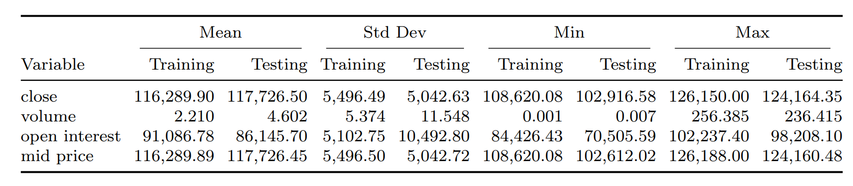
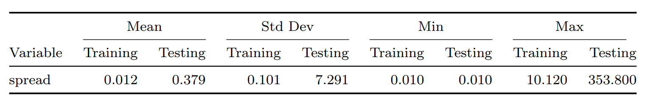
EDA Outcome and Analysis
Statistics Analysis
Significant increase in average trading volume in the testing set.
Testing set exhibits extreme spread outliers (Max 353.80), indicating potential liquidity stress.
IDA Template
Notes:
Testing Set (the right column) shows a significant increase in average trading volume.
Most importantly, Spread. In the testing set, the spread reached an extreme maximum of 353.80, compared to just 10 in the training set. This indicates a period of severe liquidity stress.

Slide 18
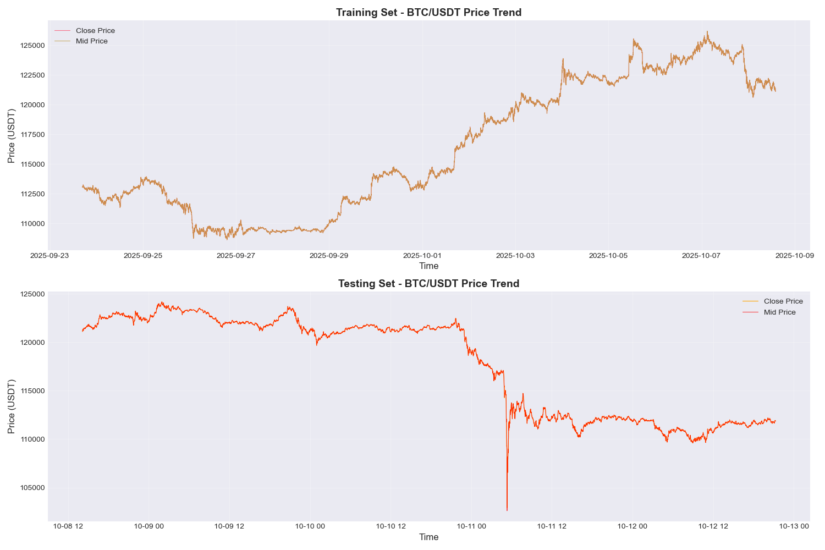
Data
IDA Template
Notes:
Testing set, where we see a sharp, significant market crash.
This is the most critical point of our data analysis: The ability of our models to capture this downward trend is the decisive factor in determining their performance.

Slide 19
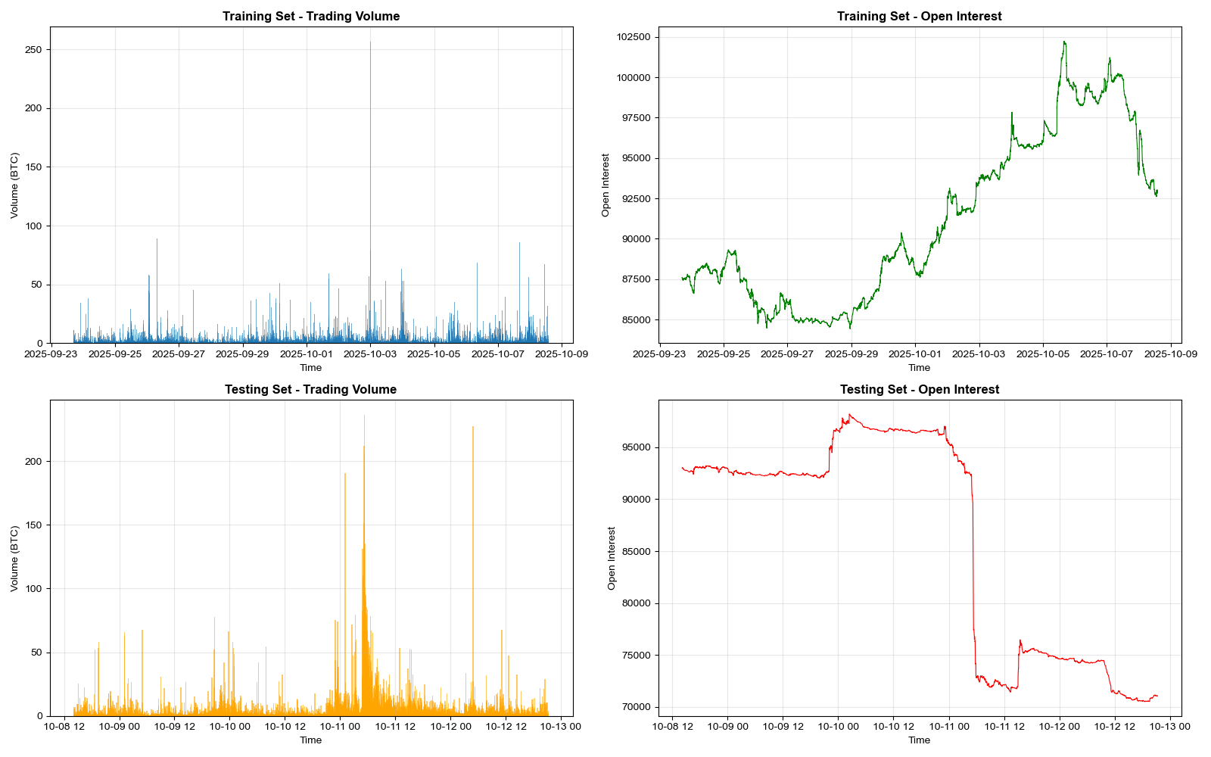
Data
Dense volume spikes and the sharp drop in Open suggesting a liquidation event.
IDA Template
Notes:
Shows the Volume and Open Interest.
Dense volume spikes accompanied by a sharp drop in Open Interest. This signature confirms a massive liquidation event,

Slide 20

EDA Outcome and Analysis
Feature engineering
To reduce signal, the 1-minute data are resampled into 5-minute intervals.
Target: future_10t_return = 50 minutes forward return(Pₜ₊₁₀ / ​​Pₜ) − 1
Predictors: 8 price momentum features + 3 microstructure features + 5 technical/market indicators
IDA Template
Notes:
We resampled the 1-minute data into 5-minute intervals to reduce noise.

Slide 21
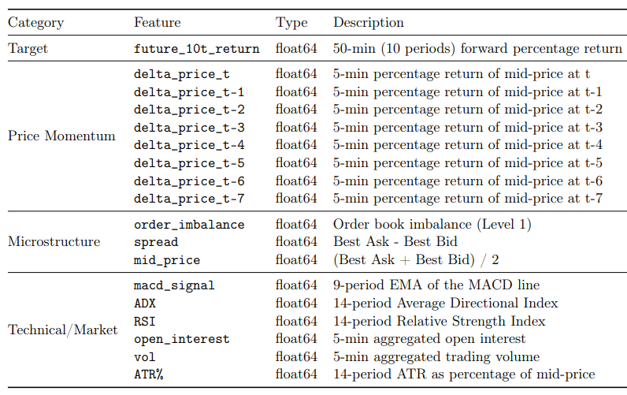
EDA Outcome and Analysis
Engineered feature definitions
The final dataset consists of one target variable and 16 predictor features.
IDA Template

Slide 22
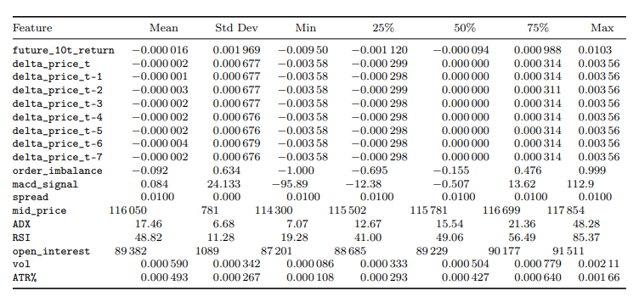
EDA Outcome and Analysis
Exploratory analysis of engineered features
IDA Template
Notes:
You can see the distributions for features like RSI are within expected ranges for this volatility.

Slide 23
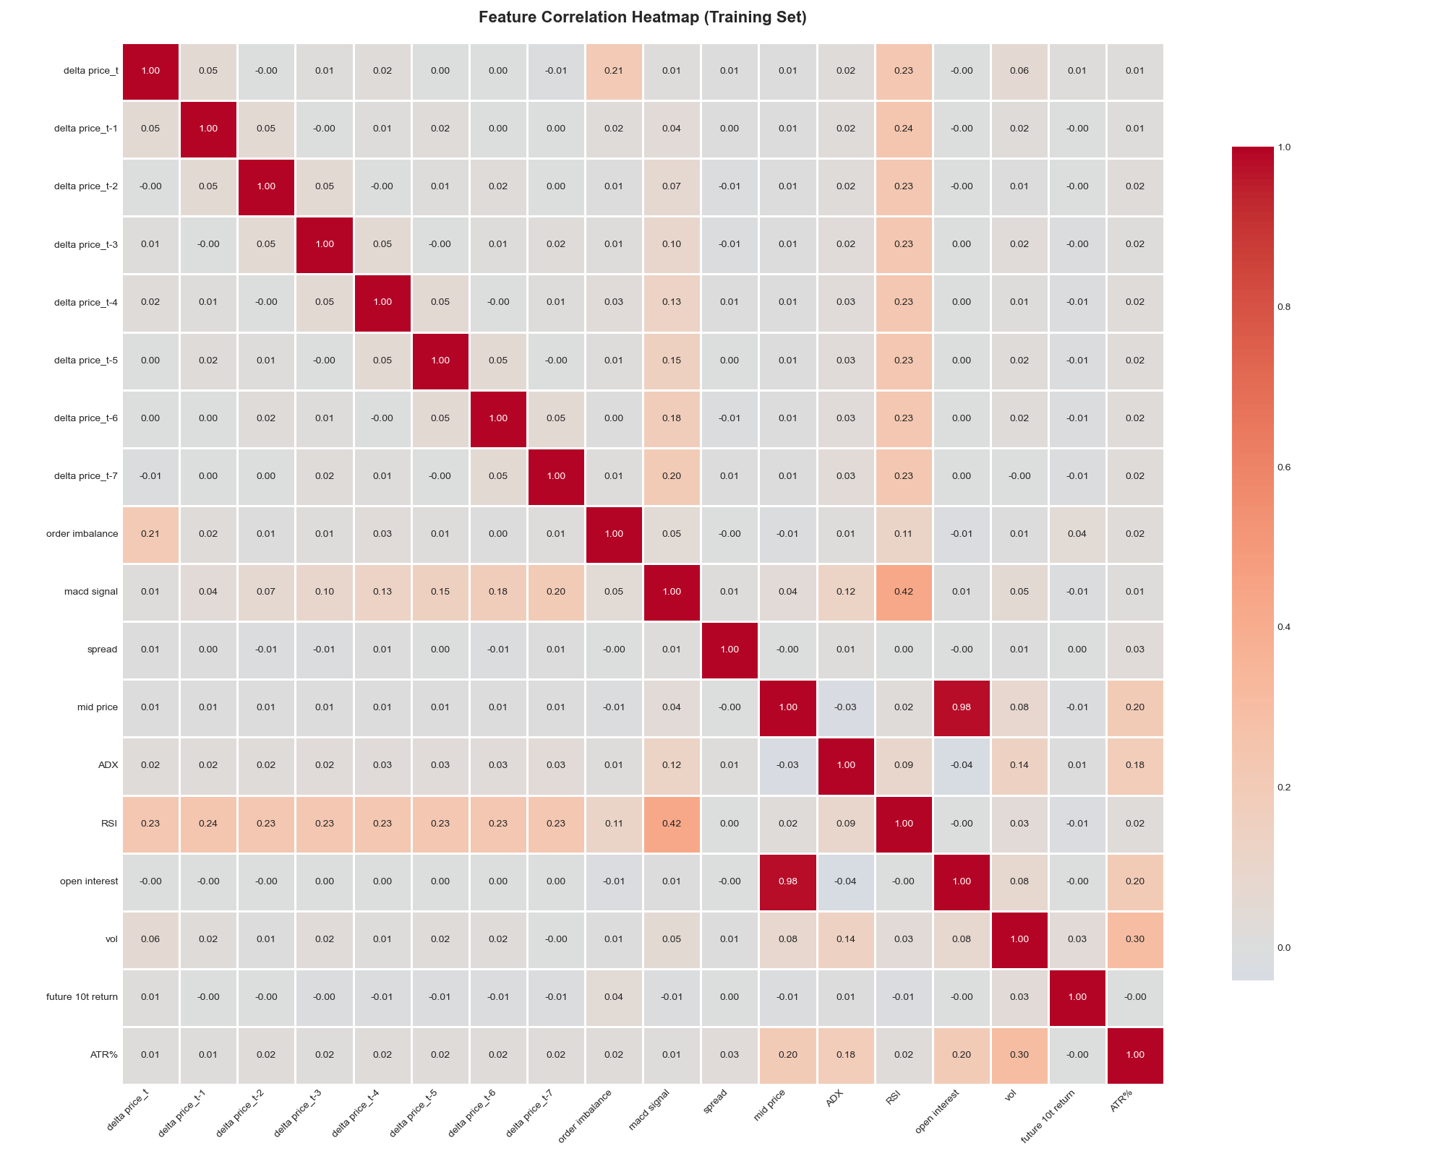
EDA Outcome and Analysis
Correlation analysis
IDA Template
Notes:
there is high correlation between mid_price and open_interest (0.98)

Slide 24
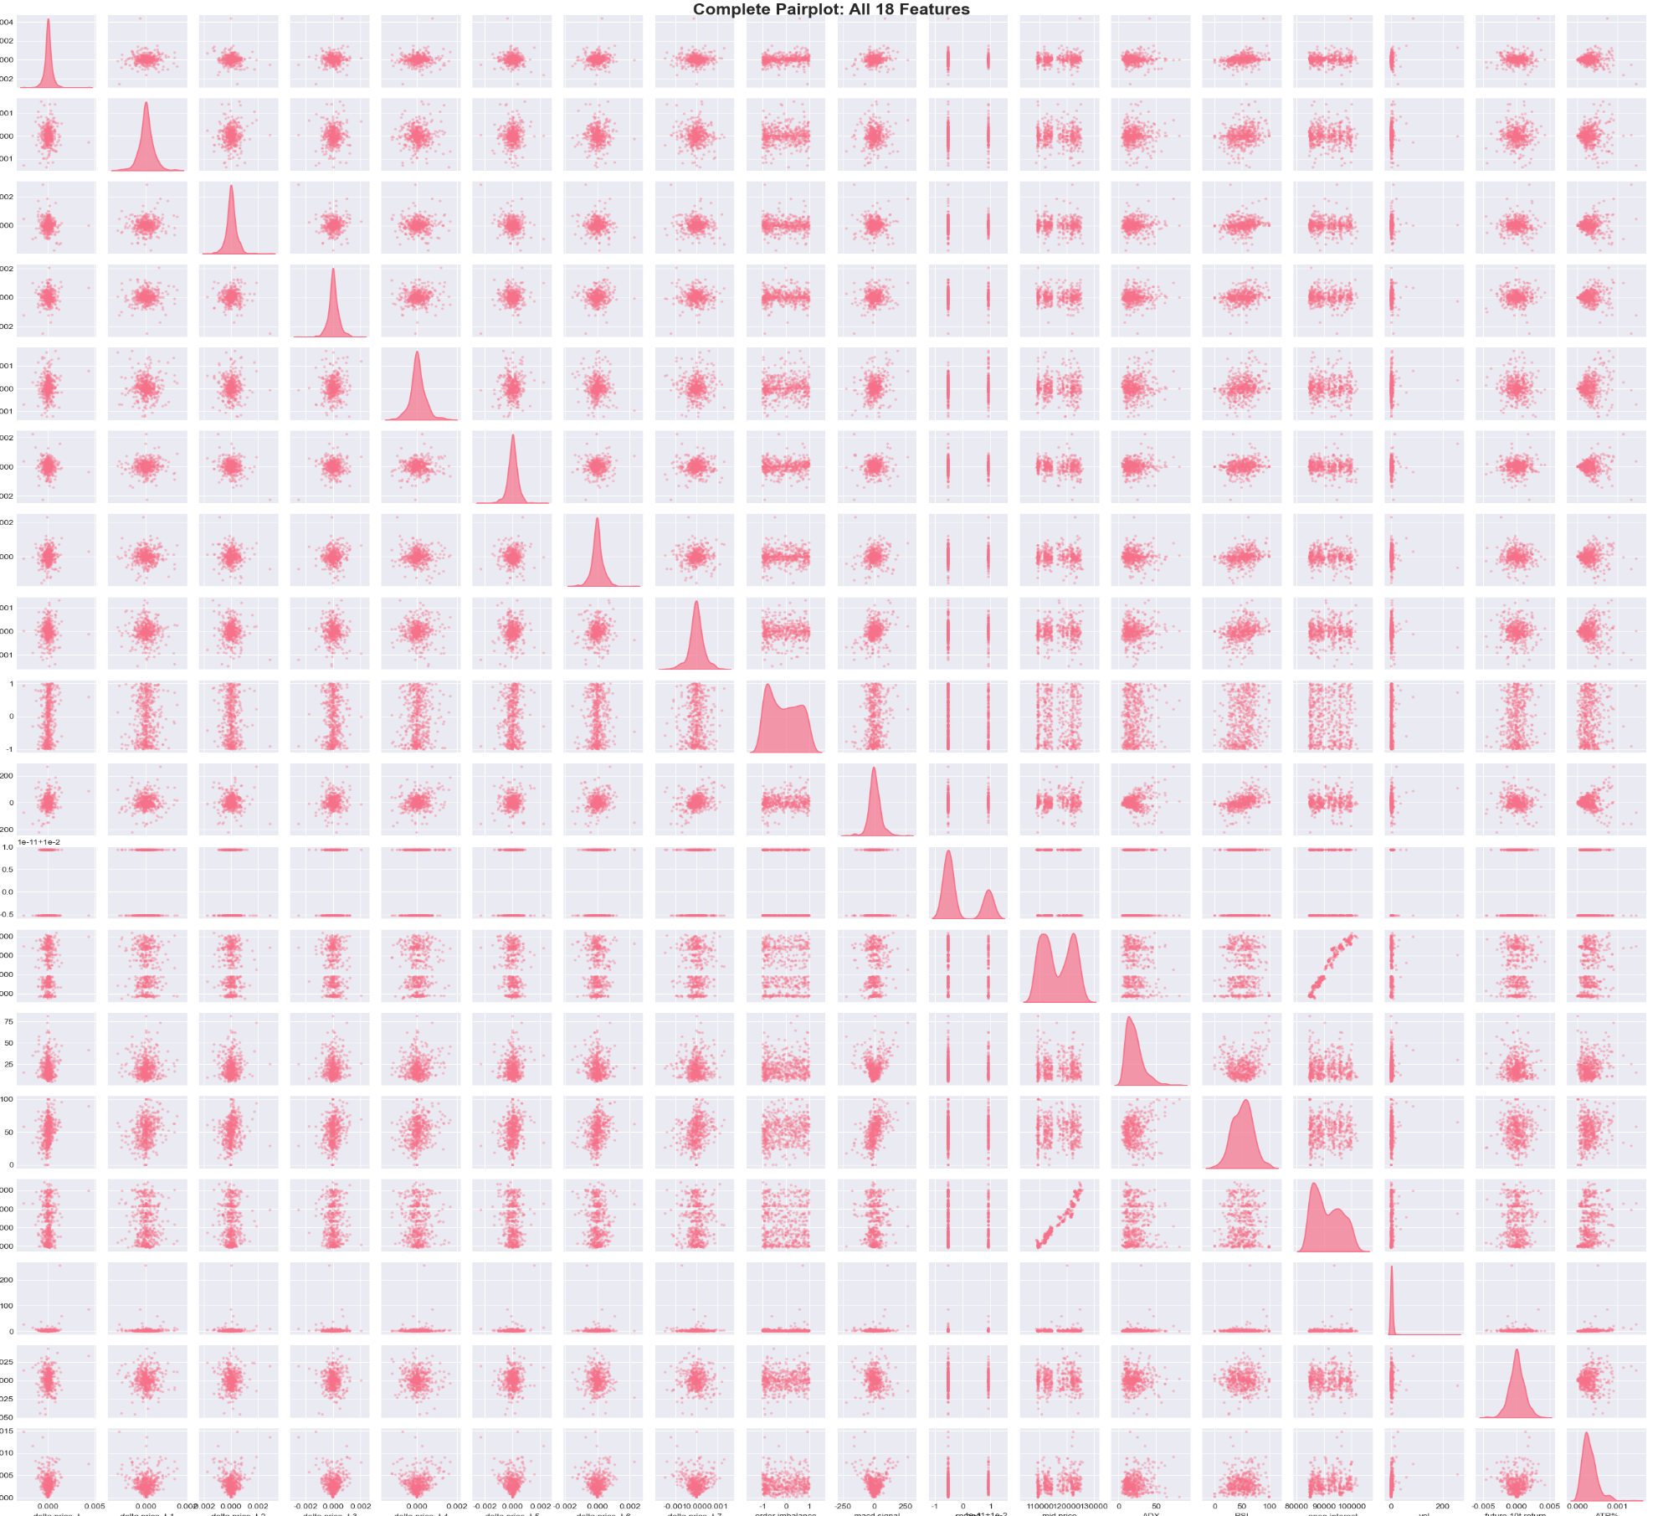
EDA Outcome and Analysis
Pairplot analysis
IDA Template

Slide 25
Benchmark model

Slide 26

Benchmark Model
IDA Template

Slide 27
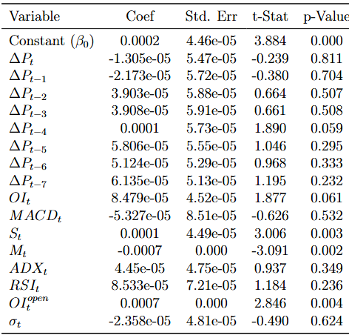

Benchmark Model
IDA Template
Notes:
Price-based variables and common technical indicators have little p
Microstructure features perform better: the bid–ask spread and mid price are significant

Slide 28
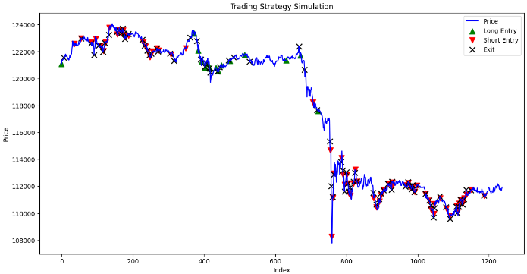
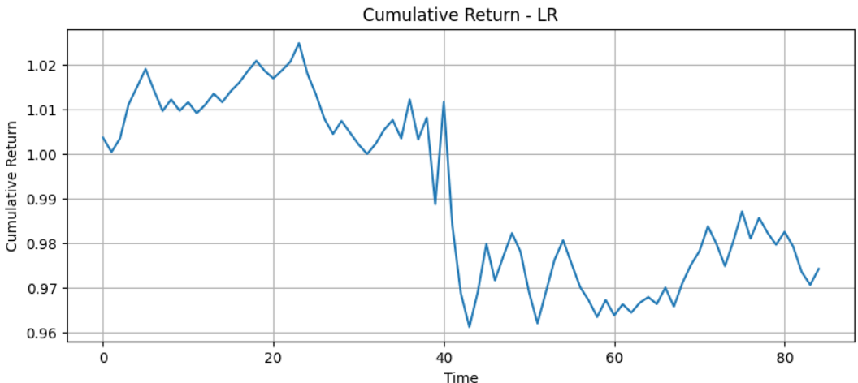
Backtest Results
Horrible!
IDA Template
Notes:
entry and exit signals
The model almost always issues short signals regardless of whether the market is rising or falling.

Slide 29
Backtest Results
Performance Measures:
Sharpe ratio: -0.8399537070702341
Max Drawdown: 0.06197069932081422
EV per trade : 0.000285
Win rate: 0.517647
CAGR: -0.9999817
IDA Template

Slide 30
Study plan & results

Slide 31
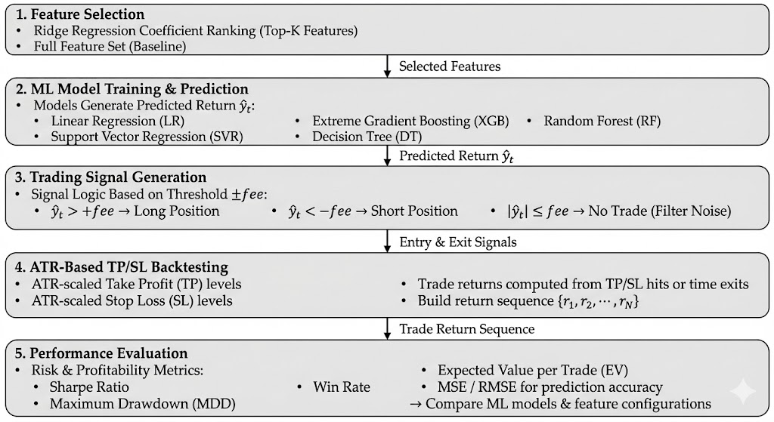
Study plan
Overall Workflow
IDA Template

Slide 32
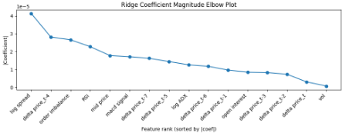
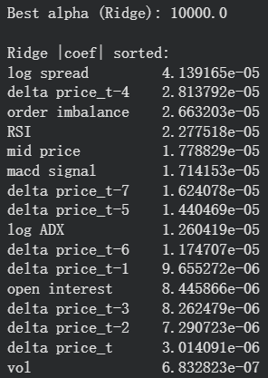
Study plan
Feature Selection: Ridge
We select k = 8
IDA Template
Notes:
Using Ridge regression and examining the coefficient–magnitude elbow plot, we observed that selecting around five to eight features would be sufficient

Slide 33
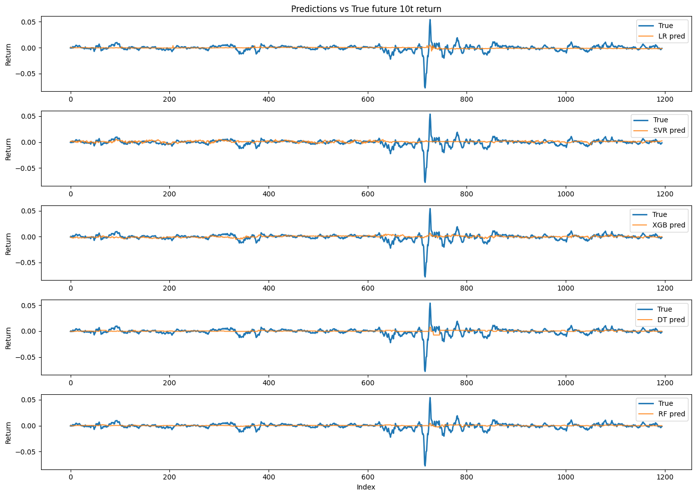
Results
y_pred V.S. y_real
Applying Models without Feature Selection
IDA Template
Notes:
Decision trees and random forests produce more conservative predictions
Support Vector Regression tends to be more aggressive.

Slide 34
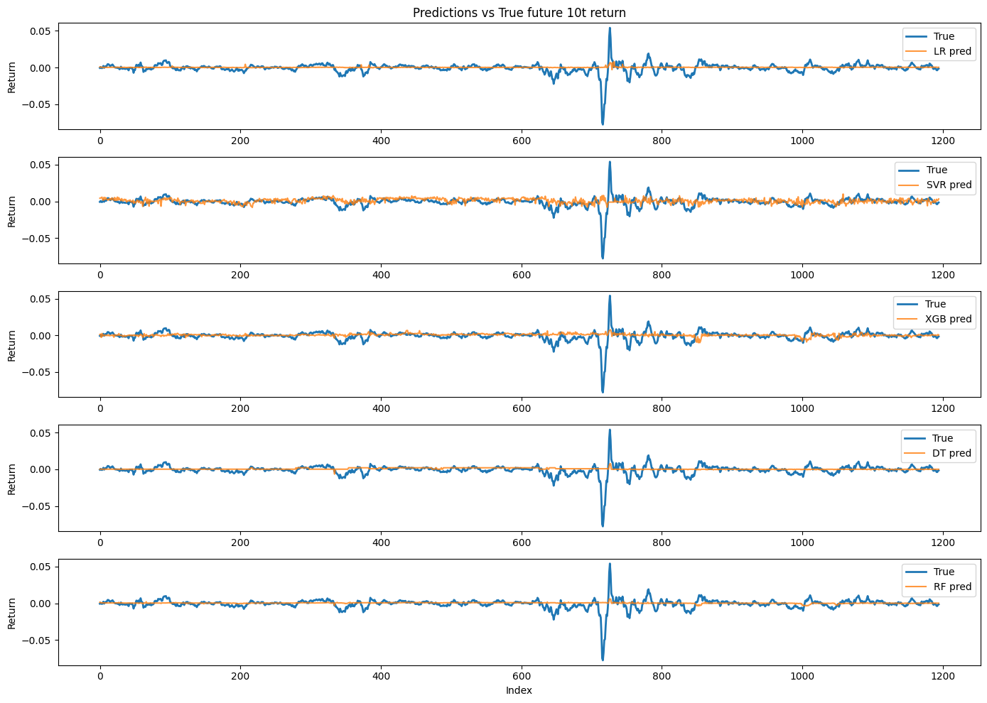
Results
y_pred V.S. y_real
Applying Models Ridge Regression
IDA Template
Notes:
the results look similar overall

Slide 35
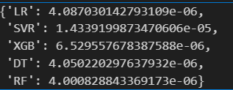
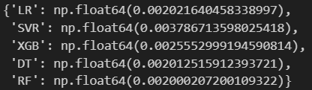
Results
MSE Results for all features:
MSE Results for ridge:
IDA Template
Notes:
MSE, using all features results in lower prediction error
With random forest performing the best and SVR performing the worst.
This pattern remains unchanged even after applying Ridge feature selection.

Slide 36
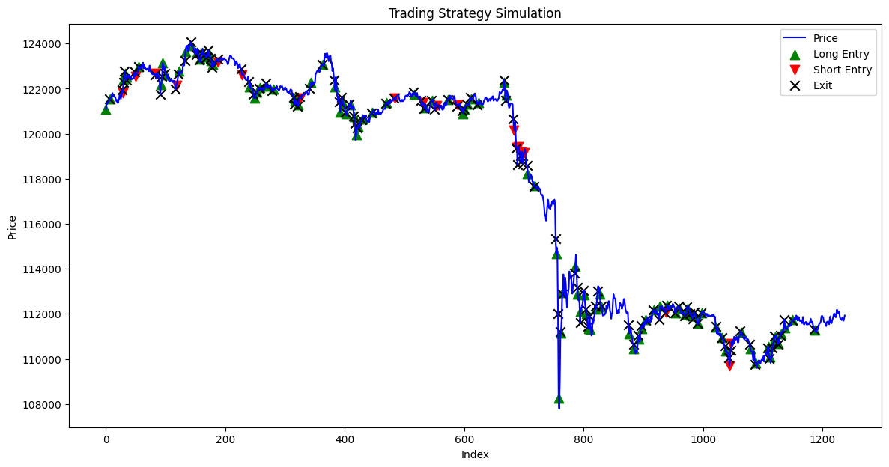
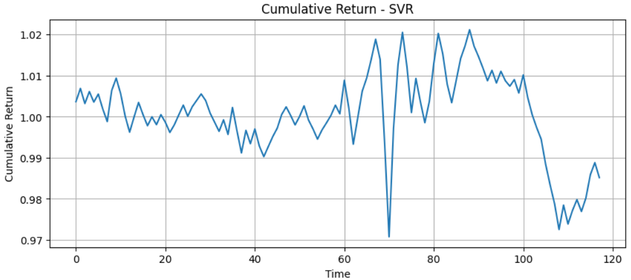
Results
SVR Trading Strategy
IDA Template
Notes:
SVR is very aggressive
SVR failed to capture this decreasing trend

Slide 37
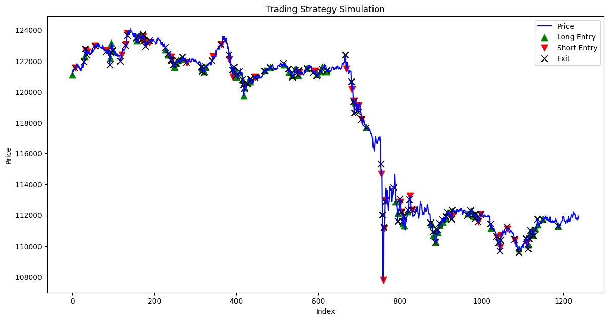
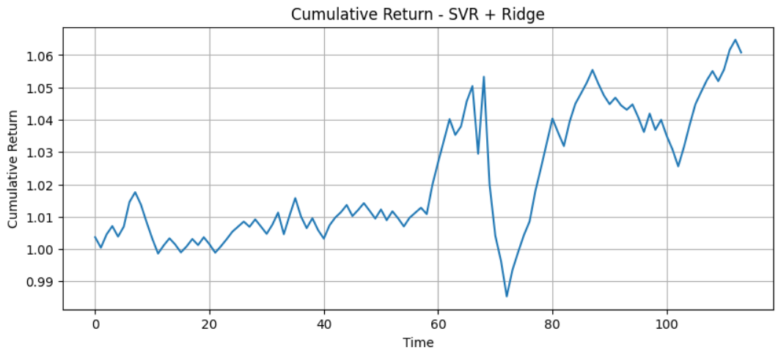
Results
SVR_Ridge Trading Strategy
IDA Template
Notes:
after it applied Ridge, we can see its improvement
Also, it performed quite well on the other part
has the most amount of improvement after applying Ridge regression.

Slide 38
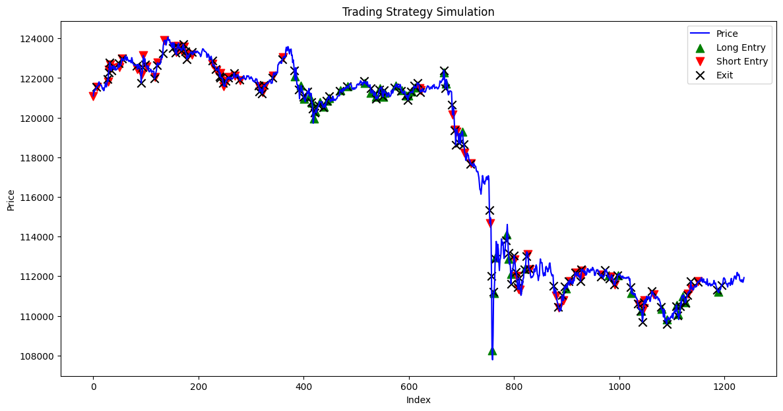
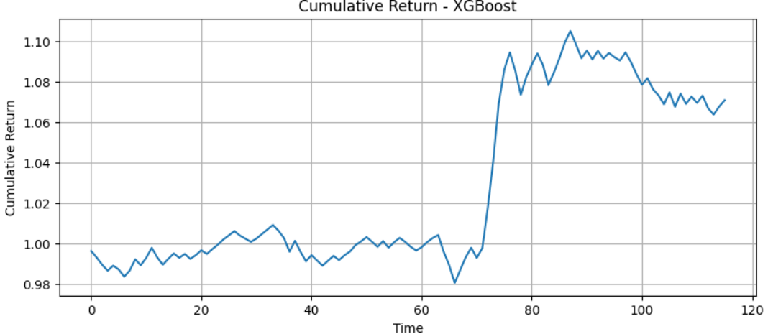
Result
XGB Trading Strategy
IDA Template
Notes:
XGBoost predicts poorly from the start
However, it not only captured the decreasing part, but also perfectly predicted the reverse point,

Slide 39
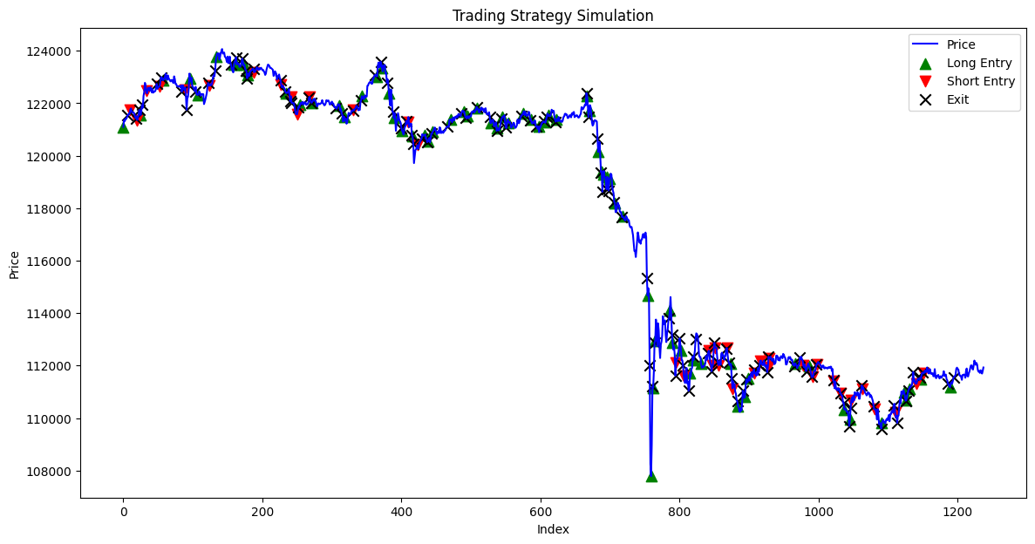
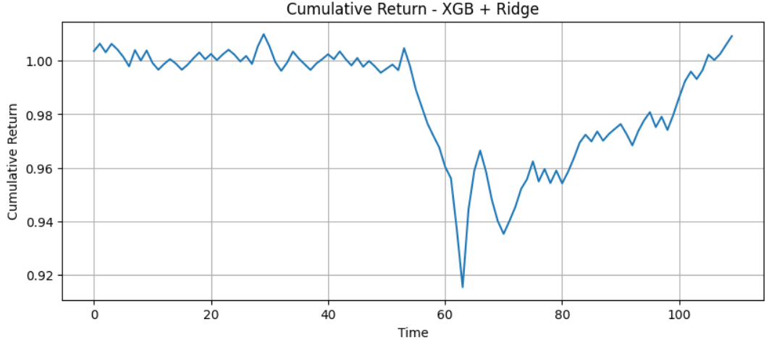
Results
XGB_Ridge Trading Strategy
IDA Template
Notes:
However, after applying Ridge, it performed poorly almost everywhere.

Slide 40
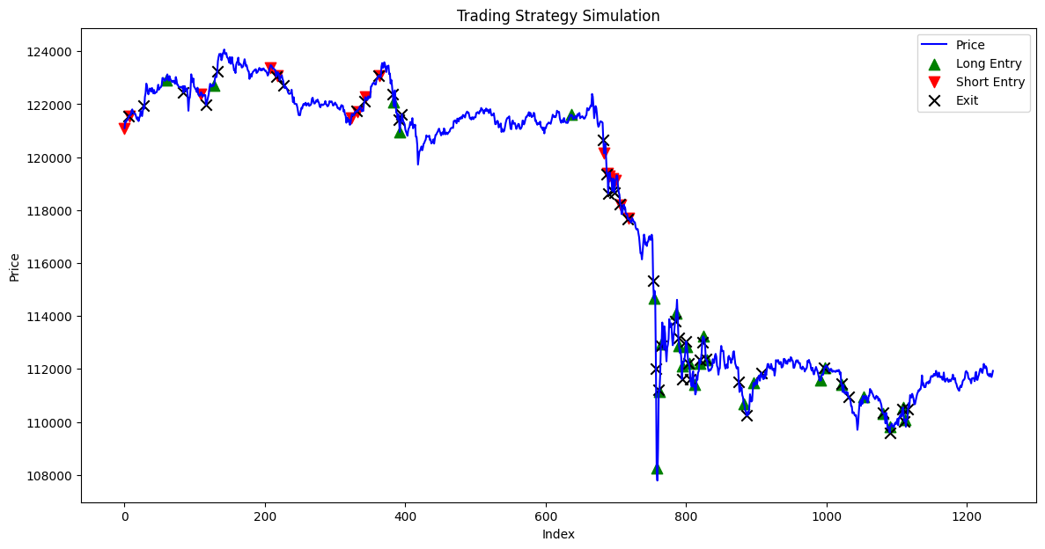
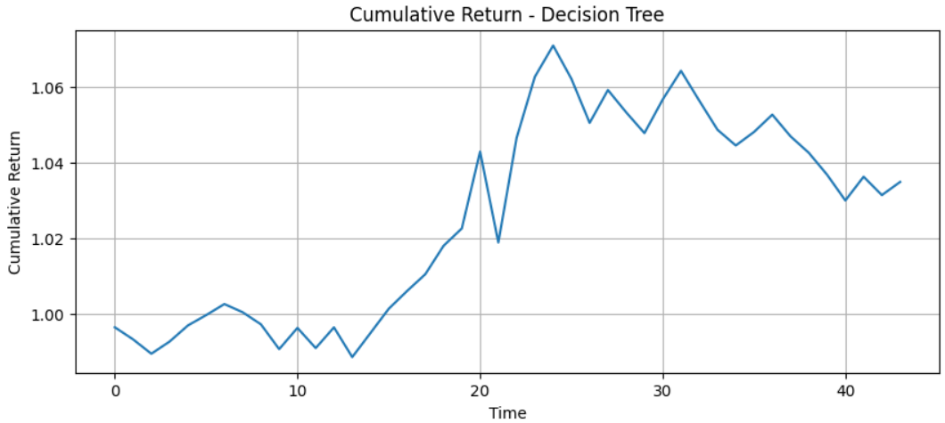
Results
DT Trading Strategy
IDA Template
Notes:
it is more conservative
it performed poorly at the start and the end,
it captured the decreasing part and also captured the increasing part

Slide 41
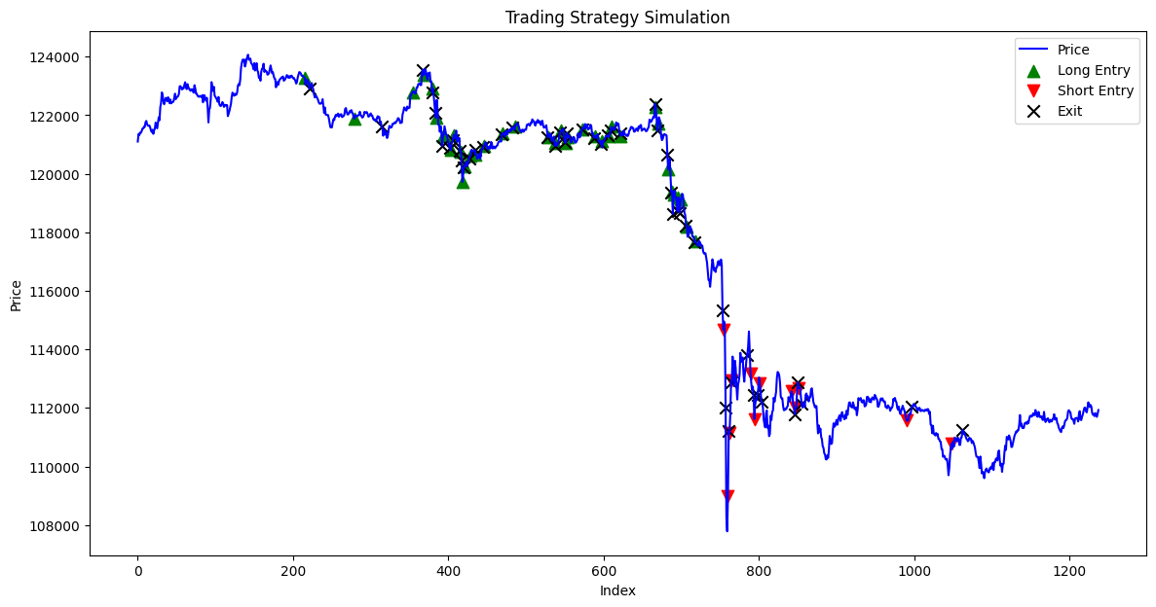
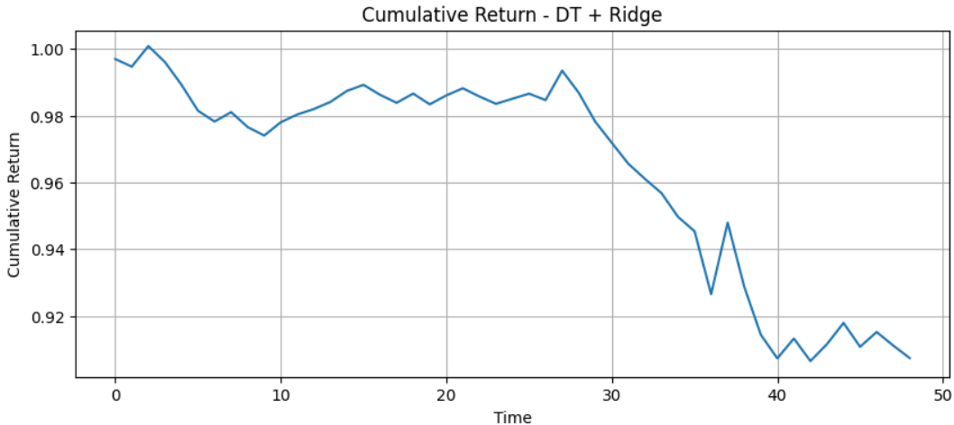
Results
DT_Ridge Trading Strategy
IDA Template
Notes:
its performance is horrible

Slide 42
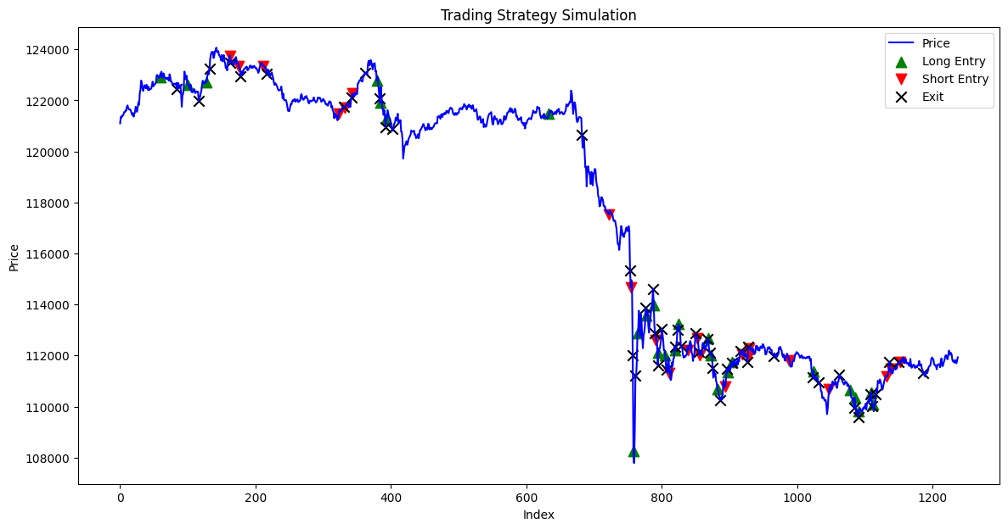
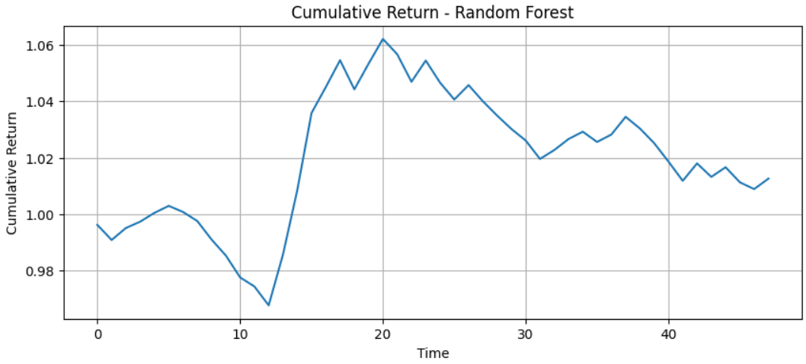
Results
RF Trading Strategy
IDA Template
Notes:
Random forest is also conservative
it also captured the decreasing part and also captured the increasing part
But it performs poorly on the rest of the trading

Slide 43
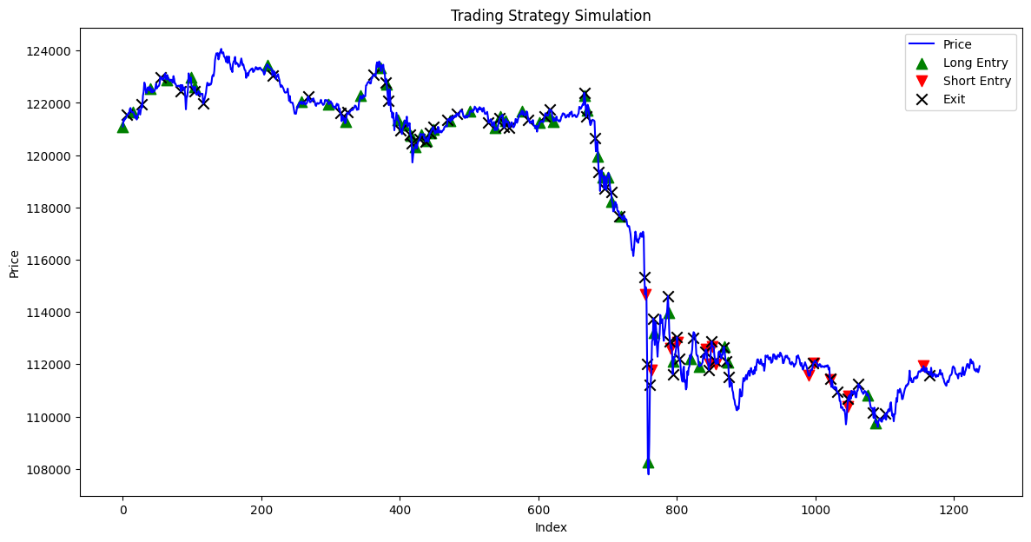
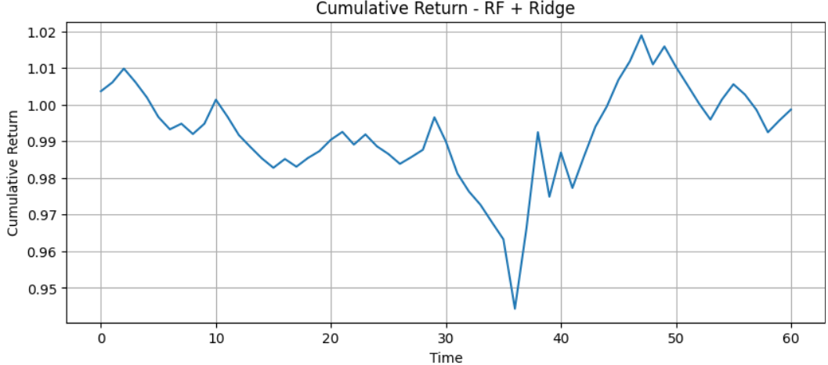
Results
RF_Ridge Trading Strategy
IDA Template
Notes:
it become more aggressive but still can’t precisely predict.

Slide 44
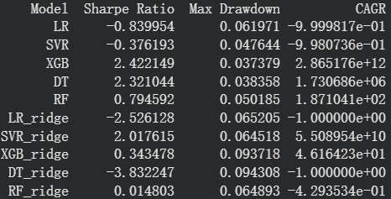
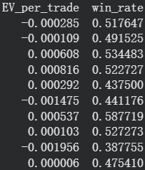
Results
Performance Comparison Across Models
XGBoost without rigde has the best Sharpe Ratio:2.422149
XGBoost without rigde has the lowest Max Drawdown = 0.037379
XGBoost without rigde has the best CAGR = 2.8651e+12
Decision tree without rigde has the best EV per trade : 0.000816
SVR with ridge has the best Highest win : 58.7719%
Overall, XGBoost wins! Also, it’s better to keep all the features.
All machine learning models outperformed linear regression model.
IDA Template
Notes:
XGBoost without Ridge achieves the best performance in terms of Sharpe ratio, maximum drawdown, and CAGR.
Decision trees again have the worst win rate

